Slide 1
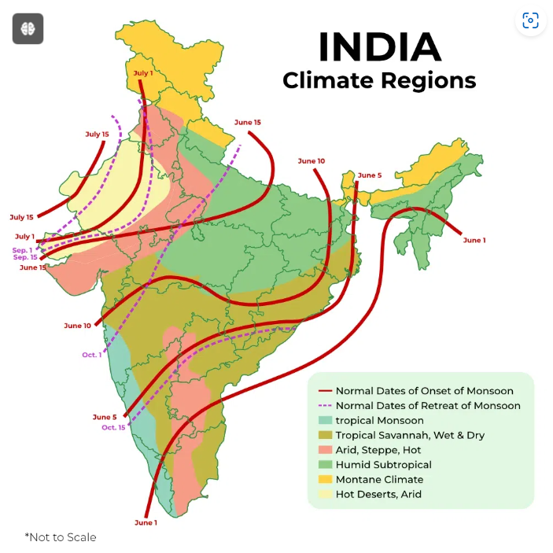
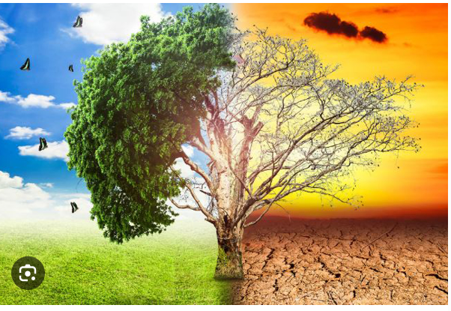
CLIMATE OF INDIA

Slide 2
1. **Definition of Weather and Climate**
- Weather dynamics: Elements like temperature, humidity, and precipitation.
- Climate vs. weather: Clear distinctions and their importance.
- Impact of weather variability on daily life and agriculture.
- Role of forecasting in managing weather-related risks.
- Historical trends in climate data collection and analysis.

Slide 3
2. **Factors Influencing Climate**
- **Latitude:**
- Influence of tropics, subtropics, and polar regions on climate.
- Case studies of cities in different latitudinal zones (e.g., Chennai vs. Leh).
- Equatorial climate dynamics and their global significance.
- Geographical variations in solar insolation and temperature gradients.
- Polar climate adaptations and challenges.

Slide 4
- **Land-Water Relationship:**
- Effects of oceans on coastal climates (e.g., Mumbai vs. Nagpur).
- Monsoon impacts and oceanic currents in Indian climate.
- Urban heat island effect and coastal city climates.
- Riverine systems and their influence on regional climates.
- Case studies on land use changes affecting local climates.

Slide 5
- **Altitude:**
- Himalayan region climate variations and hill station tourism.
- Impact of altitude on biodiversity and ecological zones.
- Alpine climates and their ecological significance.
- High-altitude agriculture and its challenges.
- Climate adaptation strategies in mountainous regions.

Slide 6
- **Upper Atmospheric Circulation:**
- Jet streams and their role in global weather patterns.
- North-east trade winds and their impact on Indian monsoons.
- Stratospheric ozone depletion and climate implications.
- Influence of El Niño and La Niña on Indian monsoons.
- Climate models and their role in predicting atmospheric circulation.

Slide 7
3. **Seasonal Variations**
- **Winter:**
- Historical trends in winter temperatures across India.
- Western Disturbances and their impact on northern India.
- Himalayan snowfall patterns and winter tourism.
- Winter agricultural practices and crop cycles.
- Urban planning challenges in winter-prone cities.

Slide 8
- **Summer:**
- Heatwave trends and urban heat island mitigation.
- Desertification risks and arid climate adaptations.
- Impact of "Loo" winds on agriculture and public health.
- Seasonal migrations and cultural practices during summer.
- Tourism trends in summer destinations like hill stations.

Slide 9
- **Monsoon:**
- Dynamics of onset and withdrawal of southwest monsoon.
- Regional variations in monsoon rainfall (e.g., Western Ghats vs. Deccan Plateau).
- Flood management strategies and disaster preparedness.
- Impact of monsoons on groundwater recharge and agricultural productivity.
- Role of technology in forecasting monsoon patterns.

Slide 10
4. **Global Warming and Climate Change**
- **Greenhouse Effect:**
- Historical trends in greenhouse gas emissions.
- Role of methane and nitrous oxide in greenhouse effect.
- Carbon sequestration projects and their impact on climate.
- Public policy initiatives to reduce carbon footprint.
- Role of renewable energy in mitigating greenhouse gas emissions.

Slide 11
- **Anthropogenic Global Warming (AGW):**
- Case studies of industrialization and AGW in India.
- Climate justice and equity in global climate agreements.
- Technological innovations for sustainable development.
- Economic impacts of climate change on developing countries.
- Role of international organizations in addressing AGW.

Slide 12
- **Effects on India:**
- Coastal vulnerability and sea level rise projections.
- Impact of glacial retreat on river systems and water security.
- Urbanization trends and climate resilience in cities.
- Regional disparities in climate adaptation policies.
- Indigenous knowledge and climate change adaptation.

Slide 13
5. **Traditional Indian Seasons**
- **Six Seasons:**
- Cultural significance and festivals associated with each season.
- Traditional agricultural practices aligned with seasonal cycles.
- Ayurvedic health practices and seasonal variations.
- Impact of climate change on traditional seasonal knowledge.
- Role of indigenous communities in preserving seasonal wisdom.

